Slide 1
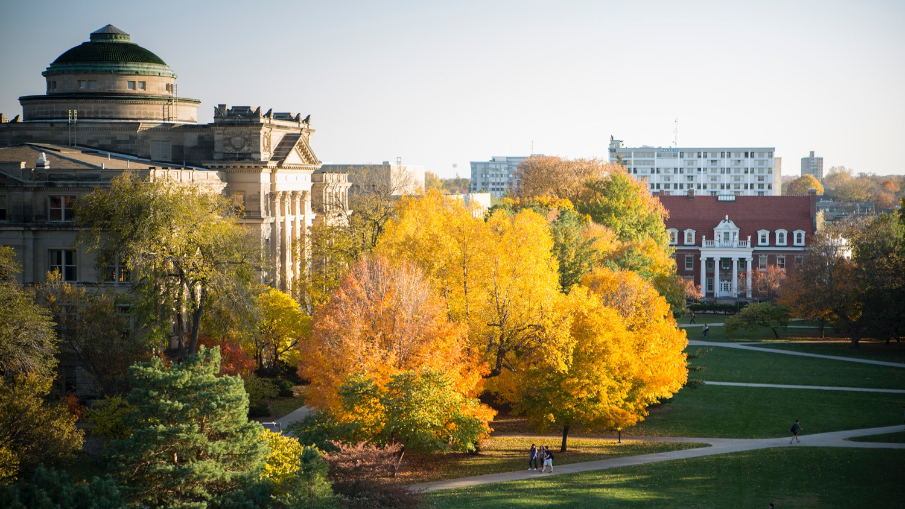

Center for Cybersecurity Innovation & Outreach
cyio.iastate.edu
Notes:
Welcome to Innovate-IT. We will go through the slideshow to discuss our program Innovate-IT more in depth

Slide 2

What is Innovate-IT? What is IT-Showcase?
AND….
Why did we choose to work on this program?
Center for Cybersecurity Innovation & Outreach
Notes:
So what is Innovate-IT and what is IT-Showcase?
Innovate-IT is a program that is all about getting people interested in IT. We treat this program like an intermural sport – it’s all about getting everyone to play and have fun. It let’s the students experience IT in a fun and engaging way. Because of their experience in IT, students will head down the path to IT –

Slide 3

Jobs, Not Enough Grads
What to do about gap?
Hope it is self-resolving
-Not viable to wait for natural cycle
Fill the pipeline
-Allow students to explore IT
-Non-threatening
-Fun
Unit or Department Name Here
Center for Cybersecurity Innovation & Outreach
Notes:
And there are lots of jobs available but not enough grads in IT – we utilize this program to build the pipeline.

Slide 4
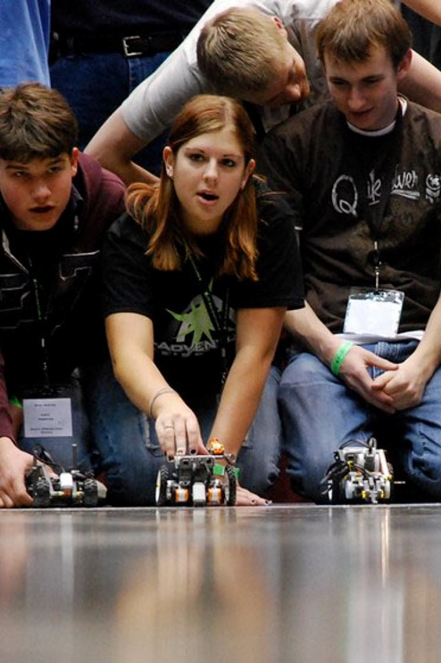
Our Solution
Increase interest in information technology on the part of high school students
-Inquiry-based learning
-Extracurricular IT-Clubs
-Competitive events
Unit or Department Name Here
Center for Cybersecurity Innovation & Outreach
Notes:
The students will always have something to work towards – this program can be extracurricular, a co-curricular club, or used in the classroom.

Slide 5
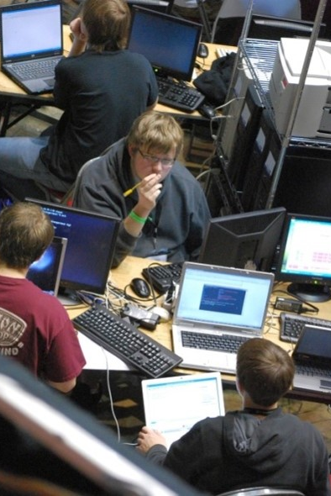
Project Goals
Increase number of high school students interested in IT
Increase number of students enrolled in IT degrees
Increase number of IT graduates who enter work force
Make IT FUN!!!!
Unit or Department Name Here
Center for Cybersecurity Innovation & Outreach
Notes:
Our motivation for this program is we want to increase the number of students interested in IT

Slide 6
How it Started
January 2006, TAI visited ISU looking for a way to engage high school student in IT. From this discussion the HS CDC was born.
Year 1 – 2006 (Cyber only)
-10 high schools
-60 students
Year 2 – 2007 (Cyber only)
-17 high school teams
-130 students
Year 3 – 2021 (IT-Adventures)
-Average of 30 high schools
-Average of 350 students
Year 4 – 2022 (Innovate-IT)
-Refreshed learning materials
-New Venue – Game Design
-New Robotics
Unit or Department Name Here
Center for Cybersecurity Innovation & Outreach
Notes:
A little history – It all started back in 2006 with some cybersecurity events: namely the cyber defense competitions, that led to discussions with TAI and those discussions led to IT-Adventures. IT-Adventures changed over the years but it always had cyber and robotics in it. In 2022 we renovated the program and rebranded to Innovate-IT. We wanted to create a new focus to allow freedom and creativity for the students. We brought back the very popular Game Design venue and changed up robotics to allow room for creativity. We used to use Lego Mindstorms but have now moved to the Hummingbird Kit which we will talk about later on.

Slide 7
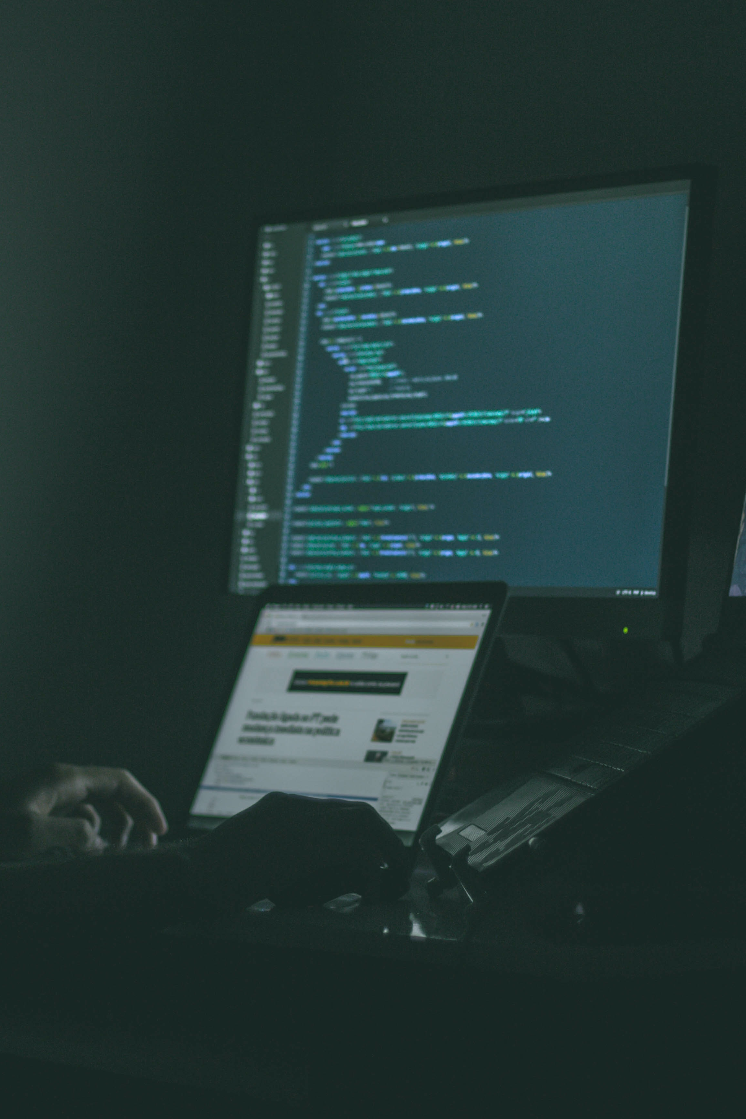
Innovate-IT - in the Fall
High schools form IT-Clubs to study content areas
Content areas (clubs can work on any number of areas)
-Cyber Defense
-Game Design
-Robotics
Unit or Department Name Here
Center for Cybersecurity Innovation & Outreach
Notes:
How it works
You can register through the Scale-Up program if you wish but you do not have to use the scale up program to participate in InnovateIT. Clubs can work in any of the venues, you can do all 3, or 2 or 1, whatever your students are interested in.

Slide 8
Yearlong Activities
Fall/Winter explore content areas using materials provided
Jan/Feb register teams for IT-Showcase
Work on primary challenge for IT-Showcase
-Cyber defense – setup network
-Game Design – write Unity game
-Robotics – create robot to solve a problem
April come to ISU for IT-Showcase
Unit or Department Name Here
Center for Cybersecurity Innovation & Outreach
Notes:
You will have access to resources for whichever venue you choose. We provide support – educational materials are available as well as contacting us with any problems you may have. We will also work with you to find a local IT mentor if needed. And robotics kits will come free with the scale-up program. We recommend 1 kit per 10 sstudents.

Slide 9

What We Provide
Free online educational materials and support
Help finding a local IT mentor
Robotics kits
Access to a cyber playground
Chat rooms for the clubs to interact with each other (Discord)
Unit or Department Name Here
Center for Cybersecurity Innovation & Outreach
Notes:
We give you a roadmap for all venues – cyber playground, Unity, the hummingbird kit. And we will utilize Discord to interact.

Slide 10
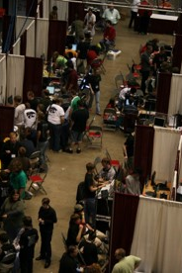
IT-Showcase – a celebration of IT
Capstone event for year-long inquiry: 1 day of fun and competitions
Company and college booths to help show there are IT jobs and educational opportunities
Great networking opportunities for students, teachers, and professionals
Three venues: Cyber, Game, Robotics competitions
FREE food
Open to general public (parents/siblings)
Unit or Department Name Here
Center for Cybersecurity Innovation & Outreach
Notes:
IT-Showcase
1 day event on Saturday. It allows students, teachers, professionals to interact. Your students will work on their projects throughout the year and then showcase them at the IT-showcase. For example, they will show their designed game through unity, or their robot designed to solve a particular task.
The Showcase is free- you only need to find the transportation to get to Iowa State University. We do provide free food during the event as well. During the Showcase you will present what you’ve worked on all year but can also compete in real time challenges.

Slide 11
IT-Showcase Venue Information
Each venue has two subcomponents that will be judged:
-primary competition (show off what you worked on all year)
-real-time competition (challenges presented during the event)
Each team is typically between 3 and 6 students
-Game design tends to be smaller and cyber and robotics tend to be bigger
-Try to keep teams below 6 so students have opportunities to participate
A club can have more than one team in a venue
Clubs are encouraged to explore all venues even if you do not intend to compete in the venue
A student may compete in only one venue during IT-Showcase
Unit or Department Name Here
Center for Cybersecurity Innovation & Outreach
Notes:
Teams are typically 3-6 students: game design tends to be smaller and robotics and cyber tend to be bigger but we can flexible with the team numbers if needed. You can have more than one team in a venue but one student may only compete in one venue. Students are encouraged to explore all venues even if you do not intend to compete in that venue.

Slide 12
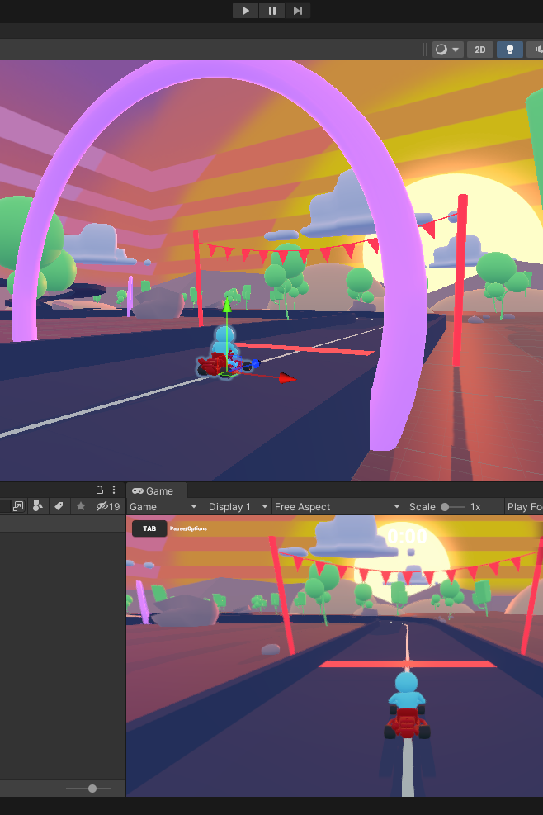
Game Design: Resources
You will need:
-Computers to install and run Unity (LTS version)
We provide:
-Suggested exercises to use during the year
-Links to resources and lesson plans
Unit or Department Name Here
Center for Cybersecurity Innovation & Outreach
Notes:
Game Design
You will use Unity to design your game. There are lots of great tutorials online and it is very easy for students to pick up. You can have no knowledge of unity and still be able to use it.

Slide 13
Primary Challenge Game Design
Each Game Design team will create an interactive game using the Unity Engine and C# coding language.
Games will be judged based on their style, creativity, and the quality of mechanics and code.
A theme and requirements will be announced in January preceding the competition.
The teams bring the game to the competition for judges and guests at the competition to play.
Unit or Department Name Here
Center for Cybersecurity Innovation & Outreach
Notes:
The game they have been working on will be judged. Other students will play the game during IT-Showcase. Judges will look through the code and give critiques. Around January we will announce the theme for the real time IT-Showcase game.

Slide 14
Real-Time Game Design
During the competition, the students on the Game Design team will be asked to design different types of games during the IT-Showcase.
The details of these games are not known ahead of time but given during the competition.
The team should produce a one-page quick start guide.
The code should be documented and submitted along with the game.
The team will be required to create a short presentation about their game to a judge/panel.
Unit or Department Name Here
Center for Cybersecurity Innovation & Outreach
Notes:
During IT-Showcase, students will be asked to build another game or modify a game

Slide 15
IT-Showcase
For each team you will need to bring:
-Your primary challenge game
- Computers to complete real time challenges with
- Any physical materials needed for the presentation/game (controllers, posters)
We provide:
- Challenges and Challenge Assets
- On-site help
Unit or Department Name Here
Center for Cybersecurity Innovation & Outreach
Notes:
They will be provided with resources to complete this challenge, all they will need to bring is a laptop.

Slide 16
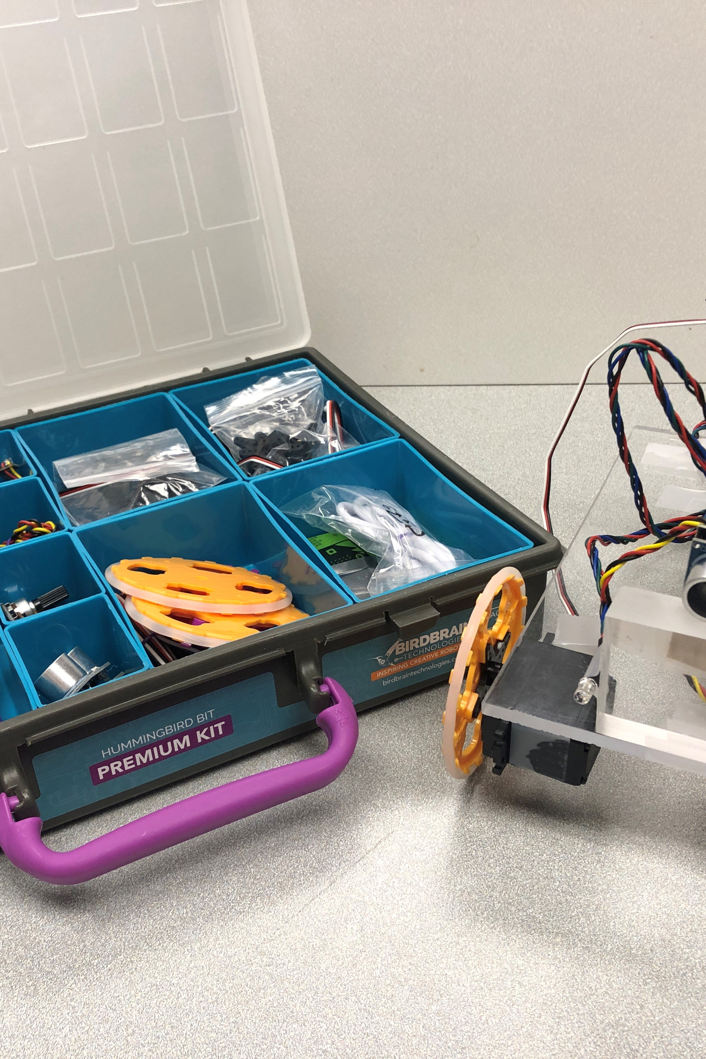
Robotics: Resources
You will need:
-Computers to run Hummingbird Software
-A Hummingbird Kit
We provide:
-Suggested exercises to use during the year
Other resources
Unit or Department Name Here
Center for Cybersecurity Innovation & Outreach
Notes:
Robotics
You will have a Hummingbird kit – the kit is bare bones, this allows the students to be extremely creative. It comes with a bunch of parts and they can put together whatever they want. They will be able to explore the software side of robotics as well as the physical building side.

Slide 17
Primary Robotics Challenge
The Robotics team(s) for each IT-Club will design, build, and document a robot using the Hummingbird Kit.
Unit or Department Name Here
Center for Cybersecurity Innovation & Outreach
Notes:
You will bring your robot to IT-Showcase

Slide 18
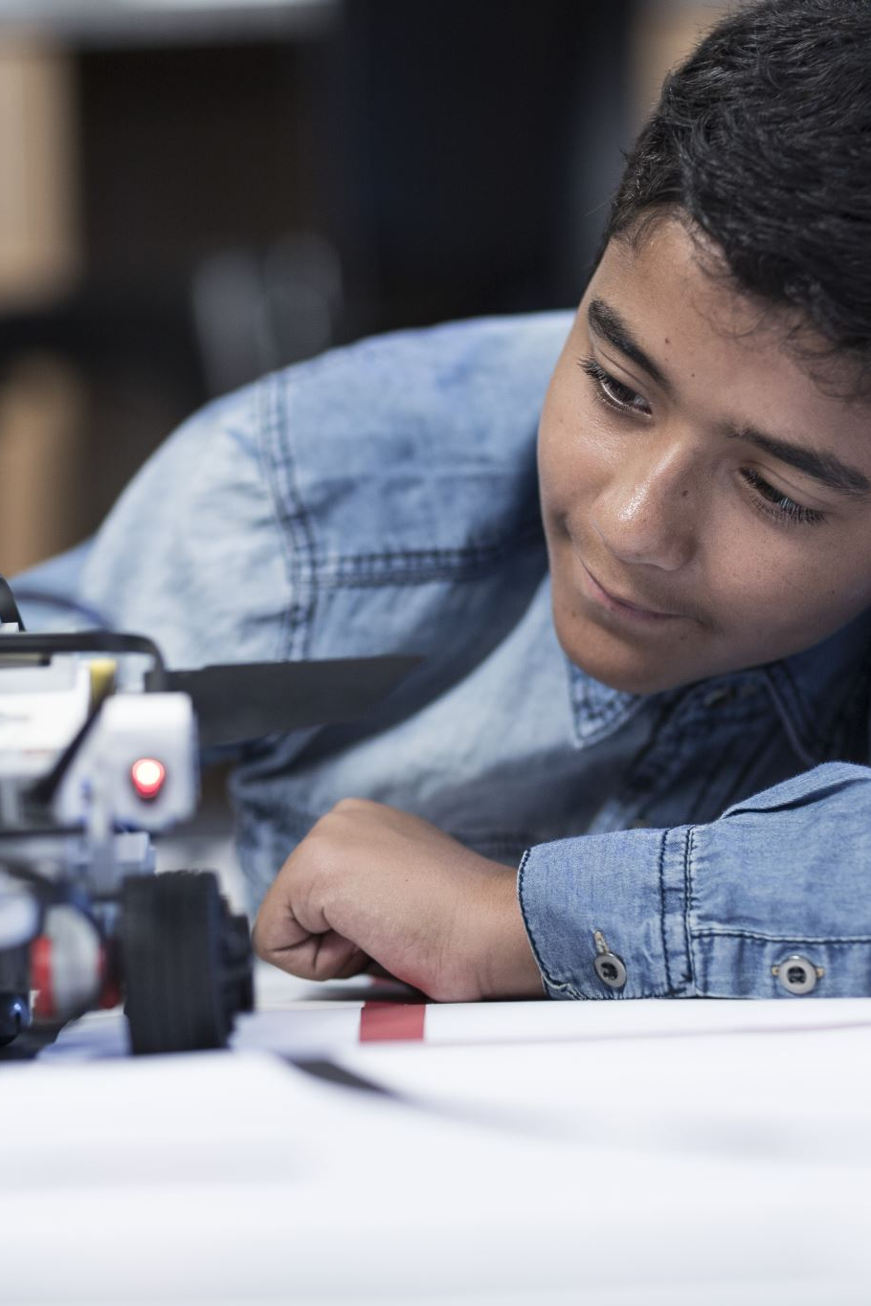
Real-Time Robotics Design
New challenges using primary challenge robot
Unit or Department Name Here
Center for Cybersecurity Innovation & Outreach
Notes:
The primary challenge there will be to use the robot they built to perform a task.

Slide 19
IT-Showcase
For each team you will need to bring:
-Your Hummingbird Kit
-A laptop computer with software (You can bring more than one laptop)
Unit or Department Name Here
Center for Cybersecurity Innovation & Outreach
Notes:
Bring hummingbird kit/your robot and laptop

Slide 20
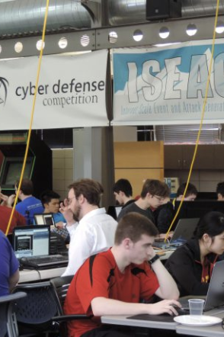
Cyber Defense: Resources
You will need:
-Computers to run access to the IT-Playground
(access is via remote desktop)
We provide:
-Cyber curriculum
-Suggested exercises to use during the year
-Access to a playground to run experiments
Unit or Department Name Here
Center for Cybersecurity Innovation & Outreach
Notes:
Cyber defense
Students play defenders. During the school year they will be learning about cyber security through the modules we provide on our website and then a month before the showcase, we will give them the scenario that will play out during the showcase.

Slide 21
Primary Cyber Defense Challenge
You are Blue Team playing the role of IT security staff.
About one month before IT-Showcase remotely connect to ISEAGE and setup rack of computers as your network.
Unit or Department Name Here
Center for Cybersecurity Innovation & Outreach
Notes:
It will be all remote and already set up. They need to set up a network environment that will have various components, servers, and firewalls. We give them everything to install all the background.

Slide 22
Cyber Defense Primary Challenge, Cont.
Setup servers such as:
-Domain Name Server (DNS)
-Mail server (SMTP and POP/IMAP)
-File sharing server (FTP)
-Remote programming environment
-Web server (many times Apache running PHP)
-End user box (Windows XP or Vista)
-Firewall (pfSense)
Chat room available for help for that one month setup time
Unit or Department Name Here
Center for Cybersecurity Innovation & Outreach
Notes:
During the school year we give them access to the IT Playground – it’s through the web, we provide the curriculum and the exercises, access to playground, everything they do is in the playground environment.
We have a whole team who is available to answer questions and deal with any issues that may come up.

Slide 23
Real-Time Cyber Defense
During the competition, you will be given tasks to complete during a brief interval such as one hour.
These are called anomalies and can be caused by the Green Team (people playing the role of your end users in your network) or by the White Team (judges).
The details of the tasks are not known ahead of time, but given during the competition.
Unit or Department Name Here
Center for Cybersecurity Innovation & Outreach
Notes:
Real Time Challenge
They come to Ames to campus on Saturday for the IT-showcase – they’ll be asked to do some anomalies to keep them distracted and then the red team will come after them

Slide 24
Red Team Also Real-Time
Red Team is the group of IT professionals and graduate students who play the role of hackers in the competition.
They will break into your network and you have to repair the damage and figure out how to keep them from using the same flaw to break in again.
Unit or Department Name Here
Center for Cybersecurity Innovation & Outreach
Notes:
Professionals and grad students are on the red team- the students need to try to detect them, repair the damage and then at the end write a report about it. They will get the hit points back if they are successful at detecting the red team’s attacks. We always tell them red is going to win but that’s why it’s fun!

Slide 25
IT-Showcase
For each team you will need to bring:
-A laptop computer (You should bring more than one laptop)
Unit or Department Name Here
Center for Cybersecurity Innovation & Outreach
Notes:
All you need to bring that day is your laptops.

Slide 26
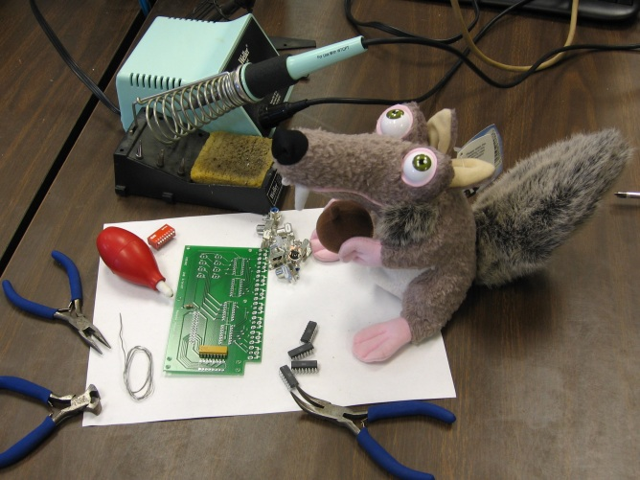
Check It Out
Visit our website at https://www.cyio.iastate.edu/innovate-it for more information or check out our informative video on YouTube.
Contact Us
innovate_it@iastate.edu
www.cyio.iastate.edu/innovate-it/
Unit or Department Name Here
Center for Cybersecurity Innovation & Outreach
Notes:
If you’d like more information about Innovate-IT, you can check out our website or our informational YouTube video. You are also welcome to contact us through email at innovate_it@iastate.edu. Thank you.

