Slide 1
Email and Firewalls
Module 7

Slide 2
Module 7 Agenda
Email
Email Protocols
Firewalls
Postfix and Dovecot
Copyright 2021 Iowa State University

Slide 3
Email

Slide 4
Email
Email is one of the most common Internet applications used worldwide.
It is used for business, personal, and retail/client use.
So how does Email actually work?
The Email system is make up of two components
Message Transfer Agent (MTA)
User Agent (UA) or Email Client

Slide 5
Email
Message Transfer Agent (MTA)
Stores and transports messages
MTAs are similar to post offices…
They receive and send mail.
They communicate with other MTAs through Simple Mail Transfer Protocol (SMTP). This is similar to the postal service.
Mail being sent is transported from one MTA to another until it reaches its destination.
MTAs also store messages waiting to be delivered or downloaded by the user.
They require authorization (username and password) to open the user’s mail.

Slide 6
Email
User Agent (UA)
Supports user interactions between the user and MTAs
Allows users to access their individual accounts, read, write, send, and manage emails
There are two types of User Agents:
Private (application based)
Web based (accessed through web browser)

Slide 7
Email
User Agent (UA)
Private (application based):
Examples: Outlook, Thunderbird, iMail)
Similar to having mail shipped directly to your house
Web based (accessed through web browser):
Examples: Gmail, AOL, Hotmail, Yahoo!
Similar to having mail be shipped to the post office to pick up

Slide 8
Email
Email System
Email users all have a unique mailing address
username@domain_name
Examples: example@gmail.com, cookiesandcream@outlook.com, ita@iastate.edu
UA’s will send emails from MTA to MTA through the Simple Mail Transfer Protocol (SMTP).
Emails of private UA’s are sent directly to their MTA
Web based emails send the UA’s through intermediate MTA’s

Slide 9
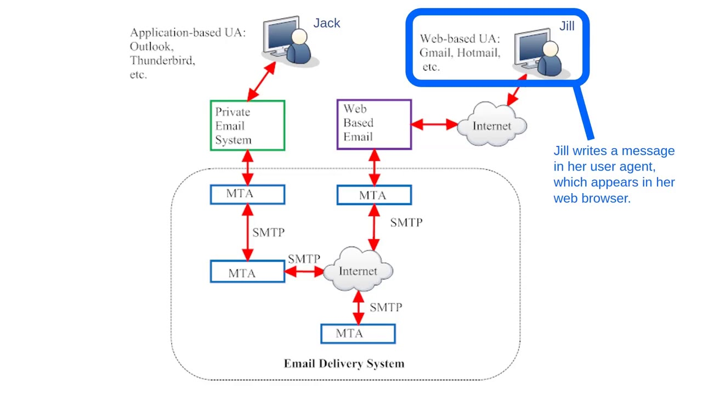
Email
https://i.ytimg.com/vi/Il0R5blCvO0/maxresdefault.jpg

Slide 10
Email
Since email is used by the majority of internet users, it is a common medium for criminals to use to carry out cyber-attacks.
Common email threats:
Eavesdropping: Hackers can observe user’s actions on an insecure network
Spamming/Phishing: An attacker will pretend to be your bank or a person in “need” in order to trick you into providing them sensitive information or even have you send money.

Slide 11
Email
Common email threats:
Address Spoofing:
the username is not really who they say there are
mikey@gmail could disguise themselves as manager@bank.com
- Malicious Attacks:
- emails containing links or attachments with
viruses and worms

Slide 12
Email
Internet safety message of the day:
Do not open emails from recipients that you do not know.
Do not click on any buttons or fields on a suspicious email, simply delete the message.
Do change your email password if you believe that a stranger has somehow been able to access your account.

Slide 13
Email Protocols

Slide 14
Email Protocols
Before explaining the following concepts watch these two videos to familiarize yourself with the topic of Protocols.
Videos:
IMAP vs. POP3
(https://www.youtube.com/watch?v=SBaARws0hy4)
Simple Mail Transfer Protocol
(https://www.youtube.com/watch?v=PJo5yOtu7o8)

Slide 15
Email Protocols
POP3: Post office protocol (version 3) is used to retrieve email from email server.
Simplest of the email protocols, and is best when a barebones email implementation is required.
Downloads new emails to your device from your inbox folder. That’s it. It doesn’t manage any changes on your other email folders such as sent or drafts.
In other words, POP3 does not synchronize.
To save space, emails are deleted off of the email server once downloaded to a device.

Slide 16
Email Protocols
IMAP: Internet Message Access Protocol.
With this protocol, multiple devices can view the content of the email message
Your folder’s contents are synchronized.
If POP3 seemed strange to you, this is probably an email protocol that you might be more used to.
The protocol you choose to use really depends on your situation, but at the end of the day, these two are used only to retrieve email from an email server.

Slide 17
Email Protocols
SMTP: Simple Mail Transfer Protocol
Protocol used to send emails.
The basic idea is that an email from your device will travel to your local email server before heading off to the recipients server, and being downloaded or viewed.

Slide 18
Firewalls

Slide 19
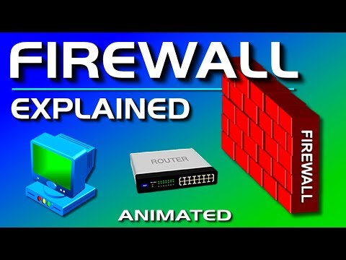
Firewalls
Some computers/networks have a software that will help protect them from hackers trying to get in.
Here is a quick video to understand the concept of firewalls
https://youtu.be/kDEX1HXybrU

Slide 20
Firewalls
Module 7 Activity 2
Teams will research a firewall for Linux they can implement: pfSense, IPTables, IPFire.
Each team will pick a firewall.
Team Members will take on different rules of research and documentation.
They will research pros and cons and how to install their personal firewall.

Slide 21
Postfix and Dovecot

Slide 22
Postfix and Dovecot
Postfix is the common Mail Transfer Agent (MTA) or mail server application for Linux.
Postfix offers features that make long term maintenance easy.
Postfix will allow you to send messages to your classmates through our network.
We will be installing Postfix on our VMs in Activity 1

Slide 23
To Do
Complete Activity One
Get a good start on Activity two
Watch the videos in the Powerpoint
Copyright 2021 Iowa State University

Slide 24
End of Module 7!
What questions do you have?
Next Module Topic:
7 Layers of Cyber Security & Web Vulnerabilities
Copyright 2021 Iowa State University

Slide 25
Questions?
Contact Innovate-IT support staff!
email:
innovate_it@iastate.edu
Your school’s IP-Range can be found at:
http://www.it-adventures.org/ip-ranges/

