Slide 1
DNS and Directory Servers
Module 6

Slide 2
Module 6 Agenda
DNS
Packages 📦
bind9
Directory Servers
Copyright 2021 Iowa State University

Slide 3
Domain Name System (DNS)

Slide 4
Domain Name System (DNS)
Warm-up Video time:
Hey! Welcome to module six, where we will be covering the topic of DNS. We’ll learn about its role within the larger internet and how to set up our own DNS server during the activity.
Before you proceed in this slideshow, watch the following video talking about DNS up to the 2:30 minute mark. Video (https://www.youtube.com/watch?v=mpQZVYPuDGU)
The “PowerCert” YouTube channel always has great IT-related content.

Slide 5
Domain Name Systems (DNS)
As you’ve seen, computers operated through numbers.
The most important numbers on the Internet are IP addresses.
Web addresses like www.google.com. are just translated version of IP address, so human can easily remember them.
When you type a domain name (www.google.com) into your search bar, your computer goes to work in translating it into its IP address.

Slide 6
Domain Name Systems (DNS)
The Domain Name System (DNS) converts domain names (i.e. www.google.com.) into IP addresses.
Think of the DNS as a telephone directory for the internet. It is used to map a name to its IP address.
DNS is composed of what are called name servers.
Resolving name servers (internet providers)
Root name servers
Authoritative name servers

Slide 7
Domain Name Systems (DNS)
Resolving Name Servers
The first step of DNS.
After searching the domain name, it is sent to the resolving name server. This is normally your internet provider
Your internet provided has a list of frequently searched domains and their IP addresses in storage. This list is called a cache.
If the resolving name server does not have the domain name and its IP address stored in its cashe, it calls the root name server.

Slide 8
Domain Name Systems (DNS)
Root Name Servers
DNS then works backwards in translating the domain name to its IP address.
The domain name (www.google.com) is sent to the root servers.
Root servers stores the top level domains (TLD).
TLD’s are website suffixes (.com, .edu, .gov, .org, etc.)
The root server guides the DNS to where the TLD name server is located.

Slide 9
Domain Name Systems (DNS)
Authoritative Name Servers
The TDL name server stores all the informations for the domain names of a certain web suffix (.com, .edu, .gov, .org, etc.)
This information leads the DNS in finding the authoritative name servers.
The authoritative name servers are usually the domain providers.
It stores the complete IP address for the specific domain name.
The IP address is then sent back to the OS to start downloading.

Slide 10
Packages 📦

Slide 11
Packages 📦
What are Packages?
- In essence, packages in Linux are small programs that help us manage other programs.
- Packages help us install, remove and update software within our Linux machine.
- Dealing with packages may seem a bit tedious, but they actually save us a lot of time and headaches. Rather than resorting to doing this manually, packages do it for us.
- The syntax of a lot of these commands will look familiar to you, especially the keyword “apt”. This is because Kali Linux uses the “apt” package manager.

Slide 12
Packages 📦
Package Manager:
accesses, installs, updates, and removes software.
some certain package manager comes already installed in each and every Linu
Package Commands:
apt install <package>
installs a specific package
apt remove <package>
removes binaries from specific packages while keeping the configuration files

Slide 13
Packages 📦
Package Commands:
apt purge <package>
removes everything in a specific package
apt autoremove
removes automatically installed packages that do not support the dependencies of the current package
apt update
updates the package database
apt upgrade
upgrades packages to the latest version in the package database

Slide 14
Packages 📦
Package Commands:
apt full-upgrade
upgrades installed packages and removes any that interfere with the whole system upgrade
apt search <package>
searches package names and their package database descriptions
apt show <package>
shows information about a specific package

Slide 15
Packages 📦
Why do Packages matter?
- Two important package-related commands are sudo apt update and sudo apt full-upgrade
- They are important because sometimes you might not see the results of a system configuration until you execute these commands and restart your computer.
- These two commands also help the user keep programs and as a result your computer as a whole, up-to-date.
-Keeping your system updated is critical for patching up old bugs or flaws that you or the package author may have introduced.

Slide 16
Packages 📦
Package Integrity:
To insure a package has not been tampered with we can install the command debsums.
sudo apt install debsums
When you run the command debsum_init, it will create hash files for packages.
As a class, use the man command to determine how to output changed files.
This command should not output any files if they have not been tampered with.

Slide 17
bind9

Slide 18
bind9
What is it?
-bind9 is a tool used to set up and manage a domain name server.
- bind9 is the latest version of the software program.
- In Activity 1, this program will contain files to help configure your DNS forward and reverse lookup zones

Slide 19
Directory Servers

Slide 20
Directory Servers
A directory service is a collection of softwares that store information about clients.
Examples:
Domain Name Systems (DNS)
Lightweight Directory Access Protocol (LDAP)
Directory services are provided by directory servers.
Directory servers are the maps of information.
Directory servers can store anything from IP addresses, to names, emails, dates, and numbers.

Slide 21
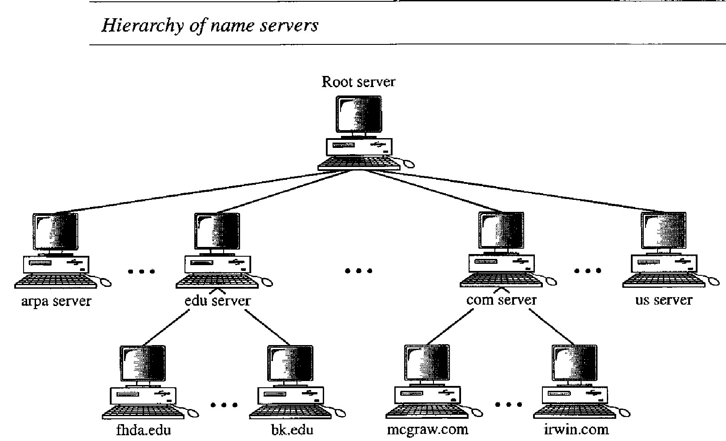
Directory Servers
Important terms:
Hierarchical naming model: used to store the directory information. (mapping)

Slide 22
Directory Servers
Important terms:
Replication: directories are copied on more than one server.
Makes information for accessible, and it is a backup for server failure
Schema: the type of information that can be store in a directory
Most of the time it is extendable (new types of data can be added in)

Slide 23
Directory Servers
Quick video for understanding…
https://youtu.be/M1eE_hGEKNY

Slide 24
To Do
Complete Activity One
Catch up on past assignments
Have some fun with the provided cyber security games! (on the outline)
Copyright 2021 Iowa State University

Slide 25
End of Module 6!
What questions do you have?
Next Module Topic:
Active Directory and Email!
Copyright 2021 Iowa State University

Slide 26
Questions?
Contact Innovate-IT support staff!
email:
innovate_it@iastate.edu
Your school’s IP-Range can be found at:
http://www.it-adventures.org/ip-ranges/

