Slide 1
Navigating Linux File System
Module 4

Slide 2
Module 4 Agenda
Network Basics
Linux Network Setup
The Linux File System
Linux Commands
Important Files
Copyright 2021 Iowa State University

Slide 3
Network Basics
Copyright 2021 Iowa State University

Slide 4
Network Basics
The Internet is a collection of computers, devices, and people, spread out all across the world exchanging information.
These networks are managed by entities known as Internet Service Providers (ISPs) “The backbone of the Internet”.
Copyright 2021 Iowa State University

Slide 5
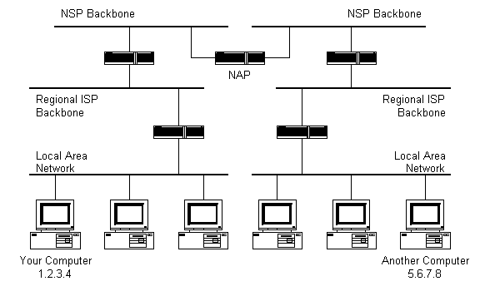
Network Basics
Copyright 2021 Iowa State University

Slide 6
Network Basics
Every computer connected to the Internet or a local network has a unique address called an Internet Protocol (IP) address.
You will configure the IP of your Kali machine in the first module four activity.
An IP address is composed of two parts. The network and the host portion.
Ex. 253.782.2.15
Copyright 2021 Iowa State University

Slide 7
Network Basics
IP-Addresses
Network Portion: Denotes a set of addresses assigned to your network. It also identifies your network “class”, which will be explained soon.
Host Portion: Helps uniquely identify each machine on your network.
Ex. For student IDs your school assigns each student the same first three numbers “223”, but different final five numbers to uniquely identify each student “223-97104”. In this example the 223 is the network portion and 97104 is the host portion.
A typical IP-Range: 192.168.1.0 - 192.168.1.255
Copyright 2021 Iowa State University

Slide 8
Network Basics
IP-Addresses (continued)
Default gateway: One of the last addresses (.254) which serves as an exit point, and forwards traffic outside of your own network.
Netmask: Defines the Class of an IP-Address.
Class A: 255.0.0.0 or “/8”
Class B: 255.255.0.0 or “/16”
Class C: 255.255.255.0 or “/24”
The class of an IP-Address helps us differentiate between which portion defines the network and which defines the host. There are two ways to write it, in the address format or the “/x” format.
Copyright 2021 Iowa State University

Slide 9
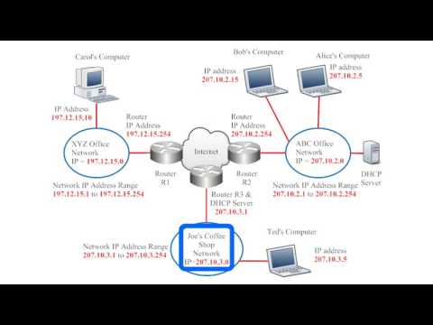
Network Basics
Video
Lesson 7: Demystifying the
Internet (Part 2)
by IowaCyber
Copyright 2021 Iowa State University

Slide 10
Linux Network Setup
Copyright 2021 Iowa State University

Slide 11
Linux Network Setup
Watch the following video before completing Module 4 Activity 1. It is an older version of the process we will use, but it still helps familiarize you with the main idea.
Video: Linux Network Setup
Copyright 2021 Iowa State University

Slide 12
The Linux File System
Copyright 2021 Iowa State University

Slide 13
The Linux File System
The Linux file system could be thought of as an inverted tree with the root directory at the top being represented by the / character.
A directory is simply a folder.
The root directory is the “base” of the hierarchy.
Other directories will then branch out from the root directory (/).
Ex: /home/Joe is the home directory of user Joe
Visit the next slide for a visual diagram of the Linux file system.
Copyright 2021 Iowa State University

Slide 14
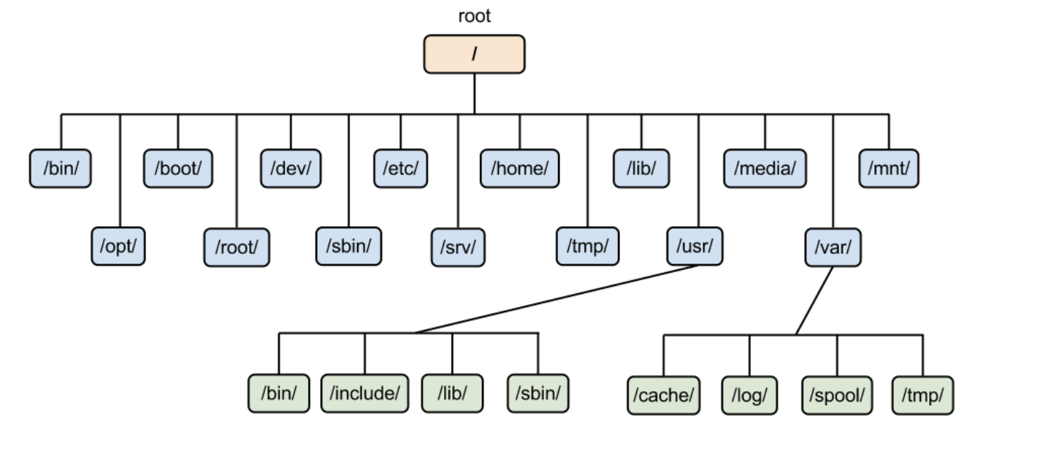
The Linux File System
File System Map:
Note: When you open a new terminal window, you will often land within the home directory of the user you are logged in as. (e.g /home/Eve).
Copyright 2021 Iowa State University

Slide 15
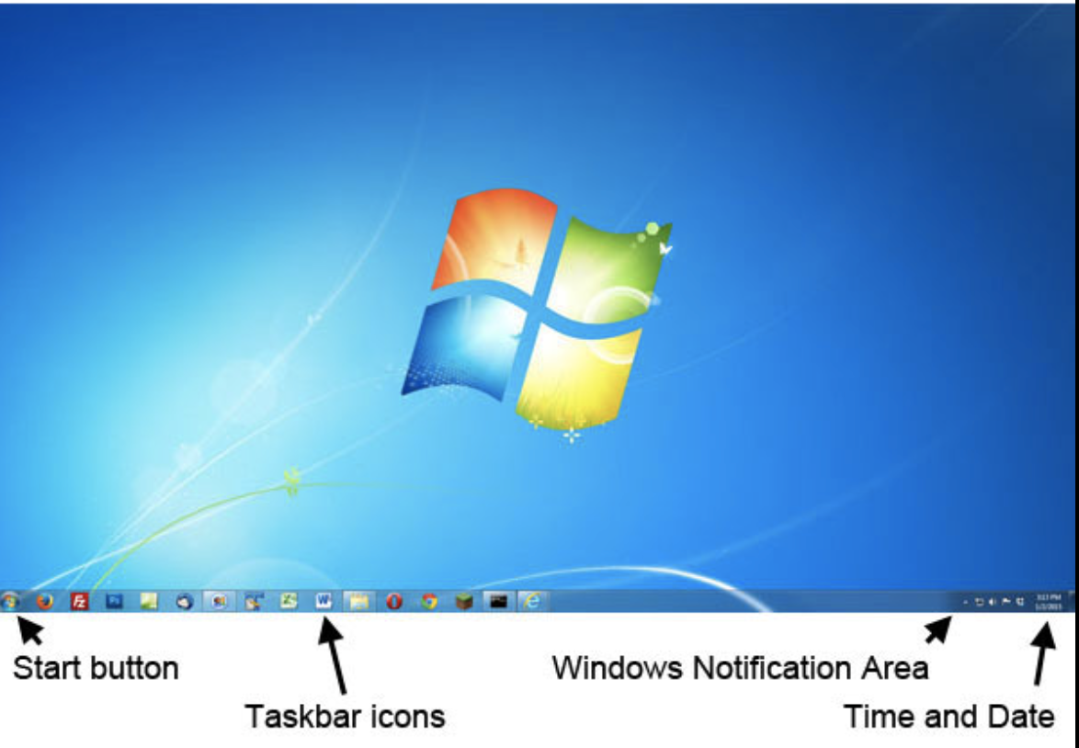
The Linux File System
It is important to know how to navigate a file system because you will not always have a Graphical User Interface (GUI) to find files/directories. You may find yourself working solely with a headless configuration. Which basically means using a terminal at all times.
A GUI includes all the icons,
buttons and graphics that
make the computer more
“user-friendly”.
Therefore, there are a list of
basic commands to help you
navigate it.
We will cover a list of helpful
commands.
Copyright 2021 Iowa State University
GUI Example (Windows 7)

Slide 16
The Linux File System
Video: The Linux File System
Copyright 2021 Iowa State University

Slide 17
Linux Commands
Copyright 2021 Iowa State University

Slide 18
Linux Commands
Nano and Vim/Vi
Nano and Vim are both text editors used to write files in Linux.
You will have the opportunity to use these in some of the upcoming activities.
Vim is the preferred editor for advanced users which is why I would encourage a beginner so start out with the nano tool.
This is the editor I personally started off with and I felt like it was very straightforward.
Copyright 2021 Iowa State University

Slide 19
Linux Commands
Navigation Commands:
tree: shows the hierarchy of a specified directory
tree /var/log will show you the contents in a tree-like format with files extending folders and directories.
pwd: print working directory
pwd will print “/home/username”, if this command is executed after opening a terminal window. Helps you know where you’re located in the file system.
ls: lists the contents of the current directory
use ls /home/Ken to list the contents of Ken’s home directory
Copyright 2021 Iowa State University

Slide 20
Linux Commands
Navigation:
The cd command: Helps us change directory and jump to another directory. Below are some examples of how it is used.
cd /home/student/Documents Will move you to the /home/student/Documents directory
cd.. Moves you one ancestor “up” in the file system hierarchy
cd Takes you directly to your home directory
cd / Takes you all the way to the root directory
cd - Moves you to your previous directory, but not necessarily to an ancestor. Akin to pressing “return” on a tv remote. It simply takes you back to the previous channel.
Copyright 2021 Iowa State University

Slide 21
Linux Commands
Directory Management:
rmdir: deletes an empty directory
rmdir <filename>
rm -r <filename> deletes a directory and all its contents
rm <filename> deletes an individual file
*Be careful with this command
cp: copy a directory/ file from its current place to a different directory
cp <source> <dest.> source is the name of the object and destination is its new location. Yes, there is a space there and you don’t need to actually use “<” or ”>”, these are simply placeholders
Ex. “cp catnames.txt /home/tom/cats”
Copyright 2021 Iowa State University

Slide 22
Linux Commands
Directory Management:
mv: moves files and/or renames files
mv file.txt /home/username/Documents would move file.txt to Documents
mv oldname.txt newname.txt renames the file when the destination is non-existent.
touch: creates blank new file
touch dogNames.txt
history: review commands you have used before
Copyright 2021 Iowa State University

Slide 23
Linux Commands
Directory Management:
locate: locates a file
- use locate -i to make it case-insensitive
- use locate -i*word to find files with a “keyword”
mkdir: makes new directory
mkdir Chips makes a new directory named Chips
mkdir Documents/Dogs creates a new directory “Dogs” under Documents.
Copyright 2021 Iowa State University

Slide 24
Linux Commands
Viewing Files:
less/more: used to view content of a file without editing it
less my_file.txt displays the file, line by line and uses “j” and “k” to scroll up or down
more my_file.txt opens the entire file to view
man: shows you several ways you can use one command. Basically a command manual.
man tail will show you how to use the tail command etc.
man tree will show you different flags/ways to use the command
man nmap provides a manual for the nmap tool
man mkdir shows you a complete command manual for the make directory command
Copyright 2021 Iowa State University

Slide 25
Linux Commands
Viewing Files:
cat: this command helps us quickly peek at the contents of a file without modification
This command displays the output to the terminal, but we can also “channel” the output to another file
cat groceries.txt displays content of groceries.txt
cat file1 > file2 makes a copy, if file2 was initially empty
cat file_name_1 file_name_2 > file_name_3 combines the contents of file 1 and 2 and places it in file 3
What is the difference between using “>” and “>>” with the cat command? Find out in the activity!
Copyright 2021 Iowa State University

Slide 26
Linux Commands
Processes: Are running applications or programs
ps: lists the running processes by Process ID (PID), this will be important once we start running multiple processes
kill: terminates a running process
kill <PID>
clear: clean out the terminal of past commands, and all kinds of junk off your screen, serves more of a convenient function than a practical one. But still incredibly helpful!
Use “;” to run multiple commands at once.
Com1; Com2; Com3
Copyright 2021 Iowa State University

Slide 27
Linux Commands
Extras:
Ctrl + C will stop and terminate a running command such as a “ping”, which could run for a long time if not indefinitely
Ctrl + Z will pause a running command
Ctrl + Q unpauses a command
*Note: Linux Commands are case sensitive
Copyright 2021 Iowa State University

Slide 28
Important Files
Copyright 2021 Iowa State University

Slide 29
Important Files
The following are files available on every Kali machine that contain important user/system information.
/etc/passwd
Does not store passwords, lists all users and other system accounts, historically used to store passwords, but you can guess why that is a terrible idea...
/etc/shadow
Will not open unless you are the root user, contains password hashes, which are simply encrypted formats of passwords.
/var/log
Can be used to examine the status of a system.
/home/<username>
your home folder
*enter the keyword “cat” followed by one the above files to view its contents!
Copyright 2021 Iowa State University

Slide 30
To Do
Watch the Linux Network Setup video
Complete Activity One
Complete Activity Two
Complete the Basic Commands Cheat Sheet
Copyright 2021 Iowa State University

Slide 31
End of Module 4!
What questions do you have?
Next Module Topic:
File Permissions and Network Tools!
Copyright 2021 Iowa State University

Slide 32
Questions?
Contact Innovate-IT support staff!
email:
innovate_it@iastate.edu
Your school’s IP-Range can be found at:
http://www.it-adventures.org/ip-ranges/

