Slide 1
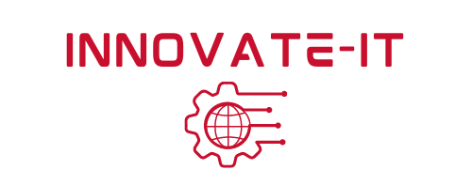
Virtual Machines
Module 3

Slide 2
Module 3 Agenda
Demystifying Computers
VMs
Virtual Machines in ISELab
Virtual Machine Snapshots
To Do
Copyright 2021 Iowa State University

Slide 3
Demystifying Computers
Copyright 2021 Iowa State University

Slide 4
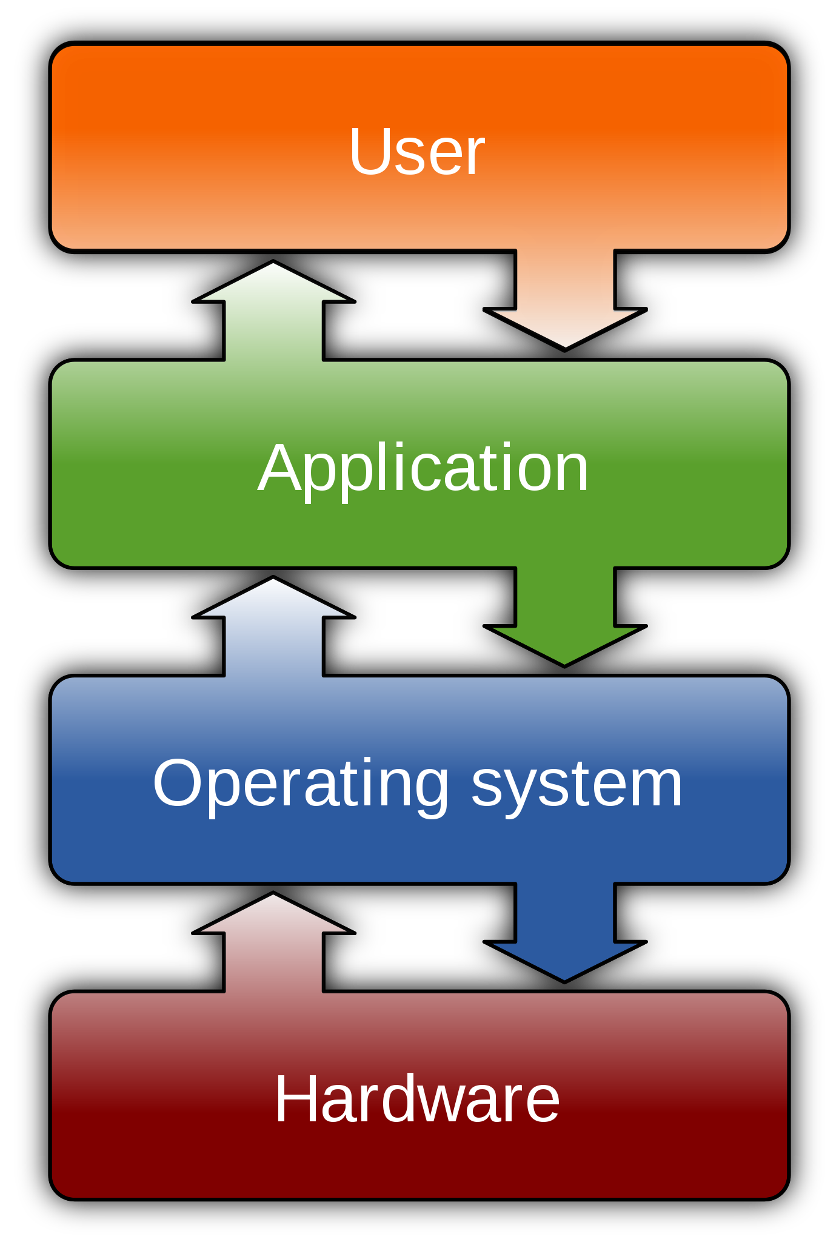
Demystifying Computers
The Four Layers of Computers
Hardware
Operating System
Applications/Software
User(s)
Copyright 2021 Iowa State University

Slide 5
Demystifying Computers
Operating System
A complex coded program embedded in computers
For Example: Windows OS, Mac OS X, Linux
Controls all the operations of the computer and its interactions with user, hardware, and applications
Hardware
The physical components that make up the computer system
For example: motherboard, hard drive, DVD drive, mouse, monitor, keyboard, connection, etc.
Copyright 2021 Iowa State University

Slide 6
Demystifying Computers
User
You!
Or anyone else behind the computer.
Applications/ Software
Installed computer programs that offer specific functions
For Example: MS Word, Email, Google Chrome.
Copyright 2021 Iowa State University

Slide 7
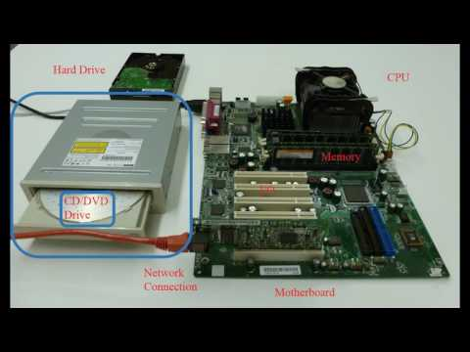
Demystifying Computers
Watch the following video for a better understanding of computers. . .
https://youtu.be/0EoY5bGSAtI
Copyright 2021 Iowa State University

Slide 8
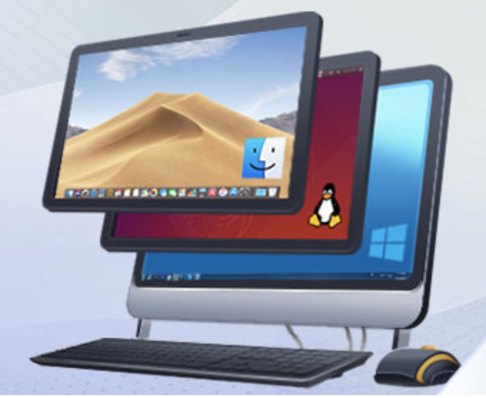
The Internet and Virtual Machines
Copyright 2021 Iowa State University

Slide 9
The Internet and VMs
In the modern world, the internet is almost ever-present.
A highly useful technological development in the area of computing has been the ability to simulate a computer within another computer.
We are able to emulate and access additional machines through the internet without actually having to buy another physical computer.
These computers within computers are known as virtual machines.
In this module’s activity you will learn how to set up your own VM. Within ISELab, the virtual playground.
Copyright 2021 Iowa State University

Slide 10
The Internet and VMs
Why should we embrace virtual machines?
More efficient use of hardware, this means allocating resources only where they are necessary.
Greater power efficiency
Virtual machines help us save physical space
Reduced setup time, setting up duplicate virtual machines can be done easily!
OS flexibility → Application flexibility
Copyright 2021 Iowa State University

Slide 11
Virtual Machines
Copyright 2021 Iowa State University

Slide 12
Virtual Machines
Virtual Machines in ISELab:
You will soon begin to set up your own virtual machines in the ISELab testing environment.
These machines will run a Linux distribution named Kali Linux
Kali Linux is used by security professionals worldwide.
This “flavor” of Linux contains a number of pre-installed tools for hackers.
We will use Kali to apply our skills.
Copyright 2021 Iowa State University

Slide 13
Virtual Machines
Teams
It is recommended that you pair up with two other people in your club to form a mini team while working through the Innovate-IT modules and the activities.
Some modules are more challenging than others, and it is always helpful to have a team of people working on a problem together than separately.
During the cyber defense competition, your entire club will be its own team working to defend yourselves against the red team.
Copyright 2021 Iowa State University

Slide 14
Virtual Machines
Setting up your VM:
The following video has an overview of how to install a VM, for your reference.
Follow the module
activity for the most
up-to-date guide.
Video
Watch it to get an idea
of what you’ll de doing.
Copyright 2021 Iowa State University

Slide 15
Virtual Machine Snapshots
Copyright 2021 Iowa State University

Slide 16
Virtual Machine Snapshots
Taking a snapshot of your virtual machine is similar to taking a photograph. The event or memory is “frozen” in time forever for you to refer to in the future.
Being able to revert back to a previous snapshot is an incredibly useful ability that saves us a lot of time and heartache. If something goes wrong, we do not always have to start from scratch.
More on this in Module 3 Activity 2.
Copyright 2021 Iowa State University

Slide 17
To Do
Watch the video of how to set up a VM
Complete Activity One
Complete Activity Two
Complete Module 3 Check your Knowledge! Worksheet
Copyright 2021 Iowa State University

Slide 18
End of Module 3!
What questions do you have?
Next Module Topic:
Navigating the File System
Copyright 2021 Iowa State University

Slide 19
Questions?
Contact Innovate-IT support staff!
email:
innovate_it@iastate.edu
Your school’s IP-Range can be found at:
http://www.it-adventures.org/ip-ranges/

