Slide 1
Information Technology Environments
Module 2

Slide 2
Module 2 Agenda
Introduction to IT-Environments
Environment Purpose and Design
ISEAGE-ISELab Overview
To Do
Copyright 2021 Iowa State University
Notes:
Talking notes: Introduce the session content objectives.

Slide 3
Introduction to IT-Environments
Copyright 2021 Iowa State University
Notes:
Talking notes: Mention that the module unit “Introduction of an IT Environment” is now starting.
(Video has multiple parts but they are assembled into common video. Slides like these break up the module)

Slide 4
Introduction
An IT-environment is a collection of network components, both physical and virtual that collectively assist an organization with its daily technology-driven operations.
Almost every organization, company or university supports and maintains an IT-Environment. The purpose and function of their environment will of course, vary.
Copyright 2021 Iowa State University

Slide 5
Introduction
IT-Environment Ownership:
Ownership tends to mean:
The individual responsible for all bills
The individual responsible of all legal matters
The people in charge of routine maintenance
IT-Environment user:
A student at a University
An employee at a corporation
A consumer of a virtual product or service
Copyright 2021 Iowa State University

Slide 6
Introduction
An IT-environment has a virtual border similar to property lines around your home
Often, common ownership across a set of components is an important quality that distinguishes one IT-environment from another
Copyright 2021 Iowa State University

Slide 7
Introduction
Internet
Example of a coffee shop IT-Environment
Coffee Shop Building
Coffee Shop WiFi
Customer 1
Laptop
Smartphone
Customer 3
Tablet
Customer 2
iPod Touch
Coffee Shop
Ordering System
Copyright 2021 Iowa State University

Slide 8
Introduction
IT-Environment Components:
Computers, Servers
Applications, Software
Some Form of Connectivity
WiFi
Wired Ethernet
Cellular
Security Measures: Firewalls, Intrusion Detection Systems, etc.
Copyright 2021 Iowa State University

Slide 9
Environment Purpose and Design
Copyright 2021 Iowa State University

Slide 10
Purpose and Design
An owner of an IT-Environment has a reason for investing in, and maintaining it.
Depending on the setting the purpose will vary
- Home: Be able to manage family finances, do school work, work from home, stream TV shows, purchasing etc.
- School: Manage curriculum and for learning.
- Business: commercial use.
Copyright 2021 Iowa State University

Slide 11
Purpose and Design
Functionality of IT-Environment must address the purpose
If it doesn’t, IT-Environment is essentially useless
IT-Environments must be affordable
Otherwise, the owner will have to prioritize other expenses, redesign, or stop using environment.
IT-Environments must be reliable
Otherwise, the owner will spend more money on additional technology or different solutions
Copyright 2021 Iowa State University

Slide 12
ISEAGE-ISELab Overview
Copyright 2021 Iowa State University

Slide 13
ISEAGE-ISELab Overview
Watch the following video...
It will be explained in the next few slides
Video:
ISERink Overview
Copyright 2021 Iowa State University

Slide 14
ISEAGE-ISELab Overview
The next slide contains a diagram of the ISERink playground, which contains ISELab.
It is a testing environment used to learn about cyber security.
Everything you do within ISELab is cut off from the rest of the internet.
This is to protect the greater internet or your network from any “oopsies”.
You will only be using the “student network” branch of ISELab. Everything else is inaccessible to you, but don’t worry you don’t really need it.
Occasionally, you’ll connect to the internet with a proxy.
Copyright 2021 Iowa State University

Slide 15
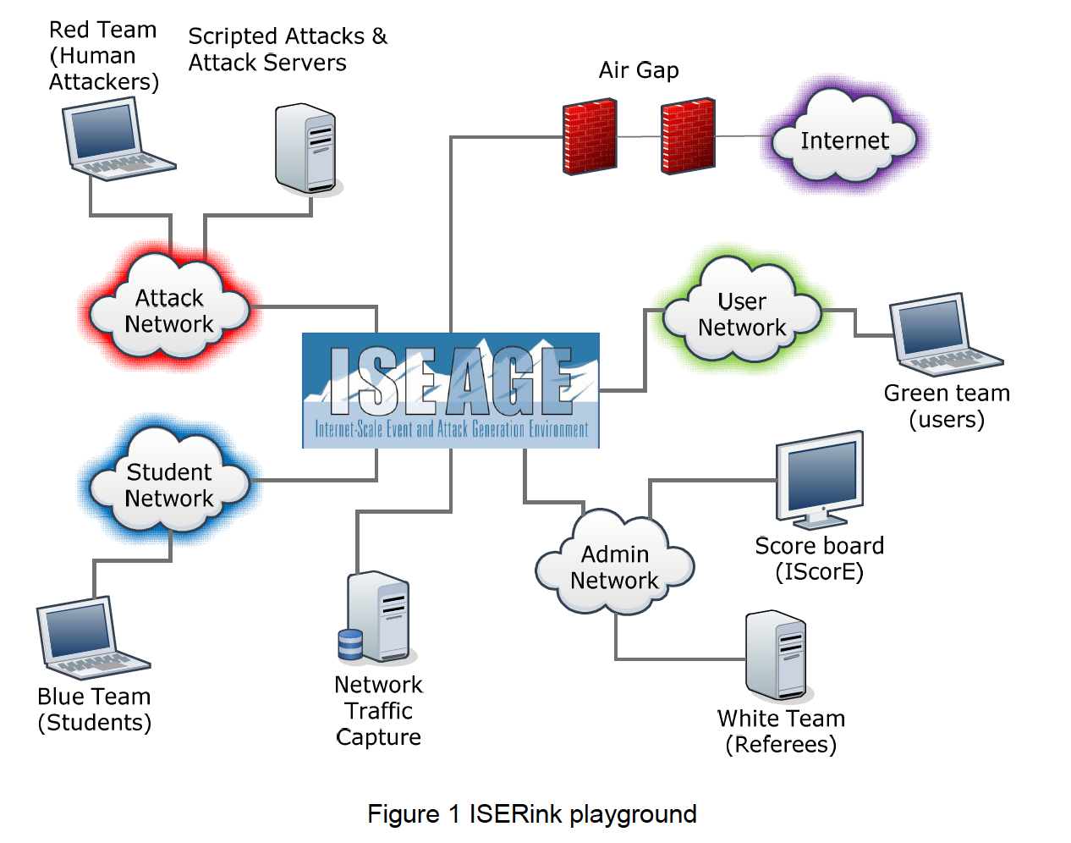
Copyright 2021 Iowa State University

Slide 16
ISEAGE-ISELab Overview
Disambiguations:
ISERink: Internet-Scale Event Rink
ISEAGE: Internet-Scale Event and Attack Generation Environment
ISELab: Internet-Scale Event Lab
Additional details:
ISERink and ISELab may sometimes be used interchangeably.
ISERink is built upon an internet testbed named ISEAGE, a subcomponent that provides a real-world networking environment for students.
Copyright 2021 Iowa State University

Slide 17
ISEAGE-ISELab Overview
ISERink is for hands on activities and the Cyber Defense Competition and should not be used for...
Online shopping
Personal use of social media
Doing homework for other classes
Any other purpose other than for Innovate-IT related use.
Copyright 2021 Iowa State University

Slide 18
To Do
Module 2 Activity 1
Module 2 Check your Knowledge! Worksheet
Copyright 2021 Iowa State University

Slide 19
End of Module 2!
What questions do you have?
Next Module Topic:
Virtual Machine Setup
Copyright 2021 Iowa State University

Slide 20
Questions?
Contact Innovate-IT support staff!
email:
innovate_it@iastate.edu
Your school’s IP-Range can be found at:
http://www.it-adventures.org/ip-ranges/

