Slide 1
Physical Security and Social Engineering
Module 13

Slide 2
Agenda
Introduction to Social Engineering
Physical Security
Copyright 2021 Iowa State University

Slide 3
Social Engineering
Copyright 2021 Iowa State University

Slide 4
Social Engineering
What is social engineering?
Think of social engineering as hacking the human mind. When it comes to social engineering within the realm of cyber security it basically means manipulating key people within an organization that you are trying to attack.
Why do hackers rely on Social Engineering?
Hackers rely on social engineering because it is a lot easier to trick a person into giving up their information than trying to break into a computer to get it yourself.
Think about it this way…
If you were to try and brute force most modern encryption algorithms you would probably be waiting until the end of time to decrypt them. Which is why learning how to exploit the weakest link, which in this case are people is the best alternative.
Copyright 2021 Iowa State University

Slide 5
Social Engineering
Video: In the following videos you will find a brief intro to the topic of social engineering as well as a professional social engineering experiment in action, from somebody that hacks companies ethically for a living.
What is Social Engineering?
Social Engineering Demonstration
Copyright 2021 Iowa State University

Slide 6
Social Engineering
The video you just watched demonstrates the power of social engineering. It can be used to circumvent even the most sophisticated security team if you are able to sweet talk company employees that are less tech-oriented.
Social engineering is always a lot of fun to see in action. Because humans are by nature “people pleasers” we aim to gain the approval of others by either being kind and holding the door open for somebody or by giving them information that they need.
But when it comes to cyber security, that can get us into a lot of trouble.
Copyright 2021 Iowa State University

Slide 7
Social Engineering
Social engineering is an area within cyber security where you don’t have to know a whole lot about computers compared to how much you need to know about people.
The human sciences predominantly stand out in this subfield. And for that reason, extensive knowledge about psychology is required. No robot will ever be able to take over this field.
In the following slides we will be going over what makes a successful social engineering attack.
Copyright 2021 Iowa State University

Slide 8
Social Engineering
Before we dive into some more text, here is a medium length video that will discuss many of the same points. (Optional to watch on own time)
I personally find it helpful to watch a video about a topic before I read about it. Perhaps we share learning habits.
https://youtu.be/tCRT3QFzwm8
Copyright 2021 Iowa State University

Slide 9
Social Engineering
Steps of a Successful Social Engineering Attack
Reconnaissance - Study Your Target
Develop an Attack Plan
Execute Your Plan
Write and Submit Your Report (Pentester)
Copyright 2021 Iowa State University

Slide 10
Social Engineering
Reconnaissance
This phase of a social engineering attack focuses on information gathering about your target.
What are the employees wearing? Business casual, jeans/t-shirt, is there a uniform?
Do you need a badge to get into the building?
Have you studied the layout of the building? Where are the exits? When is the high-traffic window?
What is the office lingo? Do they refer to the managers as “directors”, “supervisors” or “administrators”?
The goal of this first step is to make yourself as trustworthy and knowledgeable as possible so you do not stand out as an outsider.
Copyright 2021 Iowa State University

Slide 11
Social Engineering
Develop an Attack Plan
Some things to consider when you are developing a strategy to meet your objective are:
Do you need to get into a company office building? How do you plan on getting in? Will you count on someone holding the door for you?
What is your pretext or made-up story if you are caught and questioned by a guard or employee?
How will you dress to look the part?
What props or actual equipment will you carry around to complete your mission?
Copyright 2021 Iowa State University

Slide 12
Social Engineering
Execute Your Plan
Now, you don’t always have to be present physically in order to carry out your attack. If you recall from the first video, you learned that it is possible to do everything over the phone. But in many other different situations it may be crucial to be at the location in person.
Which comes with its own set of problems. It is one thing to lie over the phone and pretend to be someone you’re not but talking to people face to face requires calm and controlled body language. In addition to a confident manner of verbal communication. Lots to think about. But in the end, in order to succeed nobody should be able to tell that you are an intruder from either interacting with you or looking at you.
Copyright 2021 Iowa State University

Slide 13
Social Engineering
Submit Your Report (Reflect)
If you are a malicious hacker it goes without saying that there willnot be any report or follow up meeting to talk about your progress.
This last step is mostly for security researchers that were hired to test how well the company’s security can hold up against a threat. A professional ethical hacker would be sharing their findings with the company at this stage and possibly sharing some suggestions as to how they can protect themselves in the future.
Copyright 2021 Iowa State University

Slide 14
Social Engineering
Types of Attacks
You might have noticed that you don’t always need to interact with your target in person, in order to conduct a social engineering attack. Most attackers would actually avoid as much interaction as possible out fear of being remembered and tracked.
We will now review a number of attack strategies that revolve around the idea of social engineering in some capacity.
In the real world a successful cyber security operation would combine a variety of these methods to accomplish a goal so I would like you to remember that these types scenarios are never one or the other. You should be willing to dig underneath the surface to understand what else may be going on.
Copyright 2021 Iowa State University

Slide 15
Social Engineering
Types of Attacks - Baiting
The name of this attack on its own might give you an idea as to what this is all about. Baiting your target can be done in a wide variety of ways.
One way to bait a target could be to leave behind a USB flash drive in a parking lot or a lounge and wait for somebody curious enough to plug it into their computer.
Another way to bait your target is by approaching them with an offer that they simply cannot resist. This tactic could involve a little more research to find out what exactly could be of interest to them.
Copyright 2021 Iowa State University

Slide 16
Social Engineering
Types of Attacks - Phishing
Phishing is the practice of sending messages to your target, whether that comes from email or social media all while insisting that you are a trustworthy source.
This type of attack is very common and is usually known to originate from malicious emails. The attacker can claim that they are from your department’s IT-department and get you to click on a link that actually installs malware, or gives then access to your computer.
For this reason, it is never a good idea to open up and click on anything within an email if you do not recognize the sender.
Copyright 2021 Iowa State University

Slide 17
Social Engineering
Types of Attacks -
Spear Phishing
Spear phishing is more selective of its target. But the essence of phishing is still there. In this type of attack only one person, department or company is being targeted.
A phishing attack could also be thought of as shooting at a target blindly and hoping that somebody falls for the scam. Whereas spear phishing only aims for only one spot of the target.
Watch this short video to get a better sense of what this entails.
https://youtu.be/2IUKrxVpw3M
Copyright 2021 Iowa State University

Slide 18
Social Engineering
Types of Attacks - Whaling
Whaling is another subset of phishing that is selective of its target. However, this time the attacker is going after the “big fish”.
Whaling means going after a high ranking individuals within an organization such as a CEO or the CFO.
Copyright 2021 Iowa State University

Slide 19
Social Engineering
Types of Attacks - WiFi Phishing
WiFi phishing involves setting up a fake wireless access point. Which is also known as a WiFi Pineapple to listen in on other people’s traffic.
For example let’s say that you visit a Starbucks and you wanted to spy on people around you, what you would do is set up a pineapple in Starbucks that has an SSID or network name of “StarbucksGuest”.
People would see this connection and trust it because it looks normal.
For a visual example, watch this video on MotherBoard from 1:40 - 5:30.
https://www.youtube.com/watch?v=dysnKiXUlRU
Copyright 2021 Iowa State University

Slide 20
Social Engineering
Types of Attacks - SMSishing
If you are unfamiliar with the term. SMS is simply another word for a text message. SMSishing is a phishing attack done entirely through a text message.
This type of attack relies on short and quick messages and depends on instilling a sense of urgency. Phrases like “claim your reward now”, or “you have a pending package”, are often found on messages from a SMSishing campaign.
A few months ago I kept receiving text messages that I had a pending package from the postal service and that I had to click a link to find out how to get it. I don’t order a lot of stuff off of the internet but when I do I am tracking it daily on my phone so I knew right away that this was a scam. But what if you recently moved and thought this was just a helpful notification, then you might be in for some trouble.
Copyright 2021 Iowa State University

Slide 21
Social Engineering
Types of Attacks - QR Code
The rise of touchless ordering features in restaurants and retail stores led to widespread use of the QR code.
While there are a lot of benefits that come from contactless ordering a lot of hackers saw this as an opportunity to put up their own QR codes in trusted locations. Where people would inadvertently be visiting a malicious site.
It is impossible for a person to know where a QR code is going to direct you simply by looking at it. Which is why you should pay attention to the preview before entering any personal information.
https://youtu.be/tPC3v1LCM9A
Copyright 2021 Iowa State University

Slide 22
Social Engineering
Types of Attacks - TinyURL
Last one I promise!
If you have ever been on twitter you might be familiar with tinyURLs, which are links that are purposely shorter in order to comply with the limited number of characters you are allowed to use.
Sometimes tinyURLs come in handy because they do look more “neat” if you have a really long or awkward-looking link.
In a more dangerous scenario a tiny URL could be used to HIDE a link’s destination. So you will able to trick more people into clicking on it.
Nowadays, tinyURL offers ways to check where a link is really taking you but it is still wise to be careful.
Copyright 2021 Iowa State University

Slide 23
Social Engineering
Social Engineering within the Cyber Defense Competition
The entire CDC will have an overall theme. This is referred to as the competition scenario. There is a different one every year. One year was based on helping the police defend their systems from cybercriminals. Another scenario might involve an e-commerce theme, where you will defend the online retailer from the red team.
You are awarded points during the competition based on how well you defended your systems. And what I want you to remember is that everything that happens during the competition, will happen for a reason. The red team will try to manipulate you, in order to gain leverage by using basic social engineering tactics. So be on the lookout!
One year a fire drill was held and teams that didn’t lock their computers or sign out, lost points.
The red team also has a phone so be mindful of that...
Copyright 2021 Iowa State University

Slide 24
Physical Security
Copyright 2021 Iowa State University
Copyright 2021 Iowa State University

Slide 25
Physical Security
What is physical security?
As you might be able to guess, physical security involves any physical measure used to protect an organization’s assets. Locks, cameras, sensors, special doors and building maps, you name it.
Why is physical security important?
It might be easy to forget about physical security if your main focus is to protect something in the virtual realm.
However, it is still necessary to secure the area where your computers are physically located.
The link between physical security and social engineering is that these are two additional channels that can be used to gain access to critical information without necessarily using a computer to conduct your attack. It is often a lot easier to exploit these avenues than to carry out your mission solely through cyberspace.
Copyright 2021 Iowa State University

Slide 26
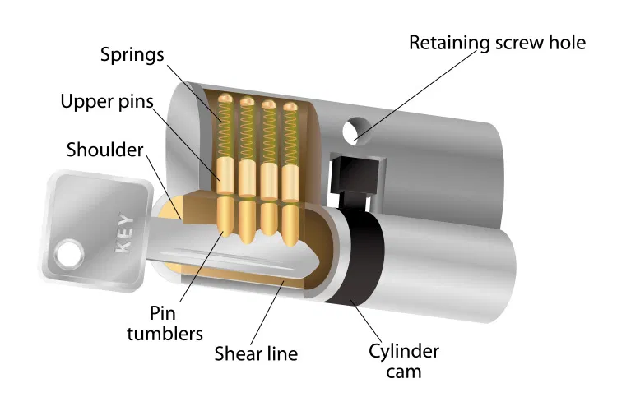
Physical Security
The Main Entrance: Doors, Gates and More!
One of the first things to consider when it comes to physical security is securing the front entrance. But how do we do this effectively?
Professional lock pickers and thieves have long figured out how to pick even the toughest locks because most operate off of the same principle of pins, springs and keys.
So you have to do better than that!
https://youtu.be/smIdInCQ-kU
Copyright 2021 Iowa State University

Slide 27
Physical Security
The Main Entrance: Doors, Gates and More!
Many times it is more efficient to circumvent the lock system by “hoping the fence” instead of trying to spend hours trying to pick the lock. Especially when you are trying to reduce your chances of getting caught. Here is what I mean by circumventing a lock:
https://youtu.be/ZcIyHdS8vmc
Copyright 2021 Iowa State University

Slide 28
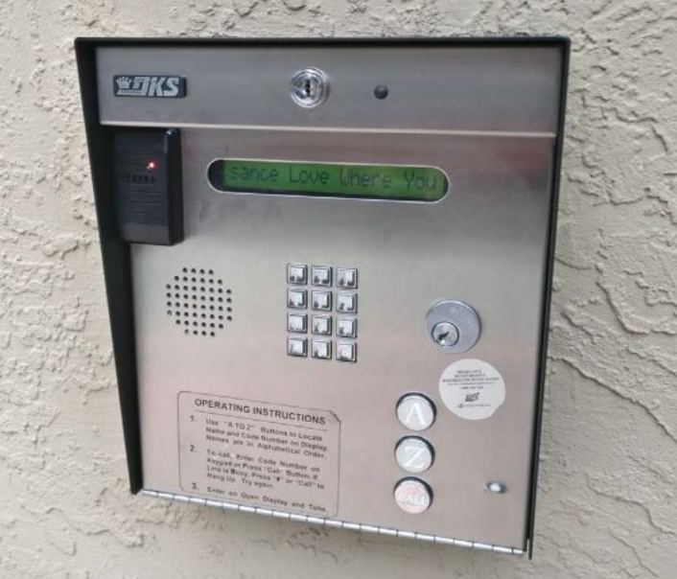
Physical Security
The Main Entrance: Doors, Gates and More!
Today’s locks lock a little more futuristic and employ the use of badges and sensors to manage people moving around in a building. Card readers at apartment buildings usually look like the one shown below. And if you study the reader you will notice that it has two key holes. The one on top is for a maintenance key which you can
actually buy online for around 10 USD if you
were to lose it.
Now, when you open the panel (next slide)
what you would find is all kinds of wires and
a “magic button”. Pressing this button
actually opens the front door and just like
that you have access to the building.
Copyright 2021 Iowa State University

Slide 29
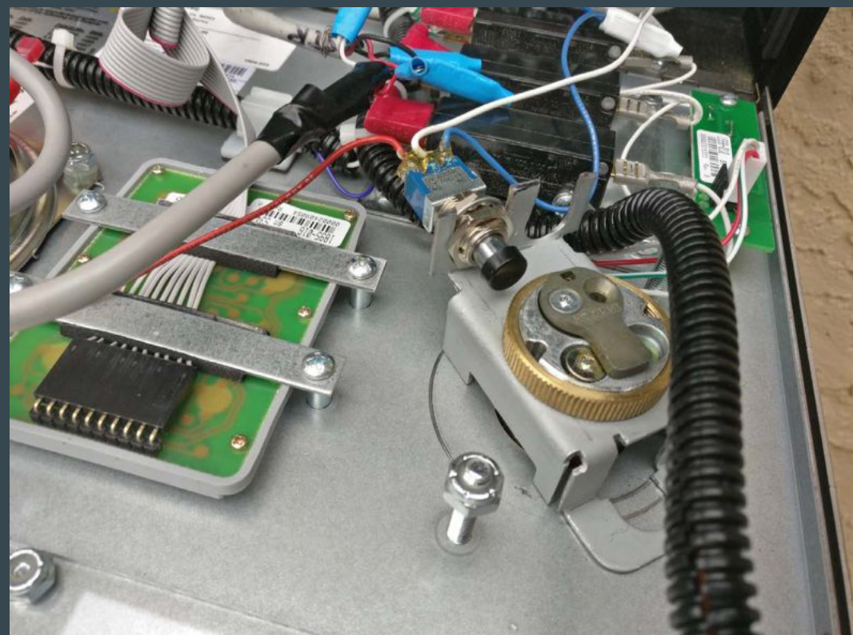
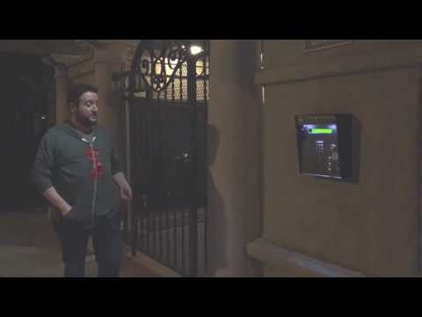
Physical Security
Security system I referenced in the previous slide.
Deviant Ollam demonstrates the use of the universal master key, which can be purchased online. On DoorKing model 16120 system. https://youtu.be/ux0POzpb9dw
Copyright 2021 Iowa State University

Slide 30
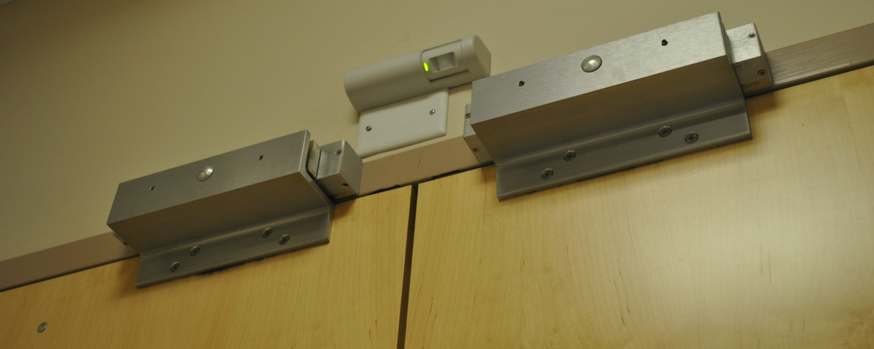
Physical Security
Sensors
The modern world if often littered with all types of different “smart” devices that aim to make your life easier. But sometimes this convenience comes at the cost of giving up some security.
Take the request-to-exit (REx) sensor shown in the middle of the photograph. These sensors are meant to open or unlock a door for people when they sense a change in temp.
Which usually indicates the presence of
a person approaching the door.
These sensors can easily be tricked
with the use of a vape or canned air.
Look at the following slide to watch a
demonstration video
of this in action.
Copyright 2021 Iowa State University

Slide 31
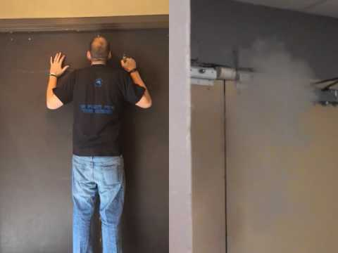
Physical Security
Sensors
I would like to clarify that these REx sensors are meant to let people out of the building when they walk up to it. So they are always placed on the inside of a building.
https://youtu.be/KSvhlxINDEU
Copyright 2021 Iowa State University

Slide 32
Physical Security
Ceilings
Drop ceilings are fairly common in the U.S and your school most likely has one of these installed. It’s not very easy to get up there and crawl around but it is possible. Most of the time you might be able to access the entire floor of the building through the ceiling alone. Which is why this type of office layout might pose a risk if there are rooms that need
to remain protected and locked.
Why try and break the lock when you
can bypass it by going through the
ceiling instead?
Copyright 2021 Iowa State University

Slide 33
Physical Security
Tailgating and Piggybacking
There is a lot to cover when it comes to physical security so the last section of this slideshow is going to deal with the two terms above. Both of these involve entering a building you should not have access to. But the manner in which you obtained access is the key difference. Tailgating would mean following an employee and sneaking in without them taking any notice.
Piggybacking would be a scenario where you are allowed to enter by an employee but only because they weren’t being careful enough to question you. Say for example, you were trying to sneak into the upper levels of the 801 Grand. And you were holding a couple of boxes of doughnuts. Not a lot of people would let the elevator door close on the person carrying doughnuts! So you could easily make your entrance.
Copyright 2021 Iowa State University

Slide 34
End of Module 13!
Main Takeaway:
The CDC will test how well you are able to protect the physical integrity of your systems in addition to evaluating your team against a potential social engineering attack from the red team. The competition is a real world simulation.
What questions do you have?
Next Topic:
Preparing for the CDC
Copyright 2021 Iowa State University

Slide 35
Questions?
Contact Innovate-IT support staff!
email:
innovate-it@iastate.edu
Your school’s IP-Range can be found at:
https://www.cyio.iastate.edu/ip-ranges/

