Slide 1
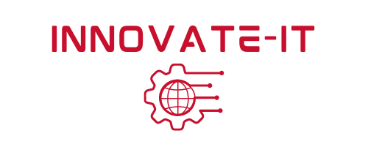
Auditing and Remediation
Module 12

Slide 2
Module 12 Agenda
Auditing
Remediation
Cyber Security Careers
Copyright 2021 Iowa State University

Slide 3
Auditing

Slide 4
Auditing
By definition, an audit is an inspection of an organization’s systems or its individual’s accounts.
There are many different types of audits that can be performed. For example….
Internal audits
External audits
IRS tax audits
Financial audits
Operational audits
Pay audits
Compliance audits
Information Technology (IT) / cyber security audits
Payroll audits

Slide 5
Auditing
As you may have guessed, we are going to focus on Information Technology/cyber security audits.
Information Technology (IT) and cyber security audits are performed in order to detect issues within computer systems and its software.
Audits help search computers for vulnerabilities that need to be patched.
*IT and cyber security audits differ from pen-tests because they are used to check what security controls are in place and if those said controls are working properly. Whereas pen-tests evaluate the entire risk level of the system.

Slide 6
Auditing
What is it:
IT/cyber security auditing is the examination of a computer system to make sure everything is clean and up to date.
It is essentially a checklist to help systems evaluate if they have the proper security measures in place.

Slide 7
Auditing
Why:
With the internet rapidly expanding, cyber threats/attacks are becoming increasingly prevalent
Auditing helps find holes within cyber security infrastructure
Auditing can help monitor network security
Audits help the user maintain updated software to protect itself

Slide 8
Auditing
How it works:
IT/cyber security audits are most often conducted by third-parties.
The computer system’s encrypted data is sent to a auditing company to be evaluated.
It is compared to regulations and is given either a pass or fail report after completion
The auditing company follows a security model to make sure data will not be exposed during the process.

Slide 9
Remediation

Slide 10
Remediation
Remediation is the process of taking some kind of action to prevent any further damage to an attacked system or to start the clean-up process after the damage has already been dealt.
What is it:
For cyber security in particular, remediation is the process of stopping and treating a data breach.
Detects and contains a breach before it grows and damages the entire system

Slide 11
Remediation
Why:
Security breaches are a major threat for companies and business.
They can expose sensitive data concerning the company and its customers
Failing to detect breaches can put companies at greater risk
How it works:
Detects and evaluates the cause of the breach
Determine how to stop the harmful activity and how to patch the damage

Slide 12
Remediation
Breaches:
On your own time throughout the week, find time to read this article about how breaches happen, how to detect them, and how to fix them. *This will be very helpful for the CDC*
How To Detect Data Breaches:
Article

Slide 13
Jobs in Cyber Security

Slide 14
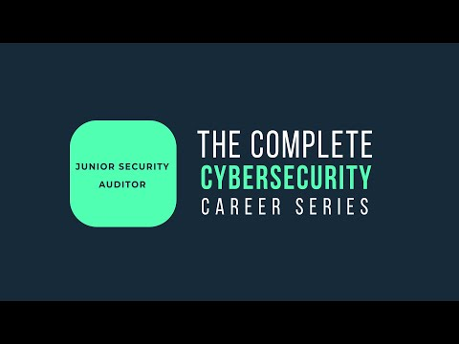
Jobs in Cyber Security
Being a junior security auditor is actually a career that cyber security students can pursue. Watch the video below that explains the job! :)
https://youtu.be/iW7W_6stSh0

Slide 15
Jobs in Cyber Security
Cyber security jobs are in high demand and offer competitive salaries
According to cybercademy.org
“3.5 million cyber security jobs are expected to open by this year”
“$83,000 is the national average salary for entry-level cyber security analysts”
Cyber security offers a variety of careers

Slide 16
Jobs in Cyber Security
Cyber security students have a lot of options for careers. Including those listed below…
Penetration Tester
Incident Responder
Cyber security Analyst
Security Specialist
Vulnerability Assessor
*We will be discovering what cyber security career is right for you in Activity 2*

Slide 17
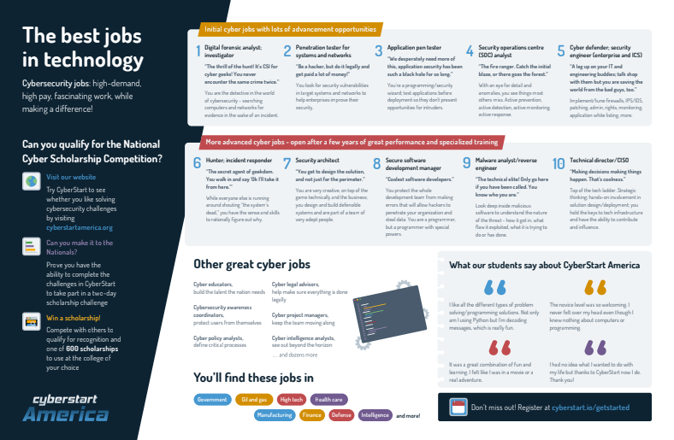
Jobs in Cyber Security
Poster Link

Slide 18
Jobs in Cyber Security
As mentioned in the previous video, basic cyber security skills include…
Knowledge of operating systems like Windows, Unix, and Linux
Programming skills in C, C++, Java, PHP, and Python (you can learn more about programming by completing the Smart-IT venue of IT-Adventures)
Elementary concepts (firewalls, access controls, malware, etc.)

Slide 19
Jobs in Cyber Security
Cyber security skills can be developed through…
Online programs/certifications
College degrees in:
Software Engineering
Computer Science
Computer Information Systems
Business Information Systems
Information Assurance

Slide 20
To Do
Complete Module 12 Activity 1
Complete Module 12 Activity 2
Read the following article: link
Copyright 2021 Iowa State University

Slide 21
End of Module 12!
What questions do you have?
Final Module Topic:
Physical Security & Social Engineering
Copyright 2021 Iowa State University

Slide 22
Questions?
Contact Innovate-IT support staff!
email:
Innovate_it@iastate.edu

