Slide 1
Cyber Defense Competition Details

Slide 2
CDC IS HERE!!!

Slide 3
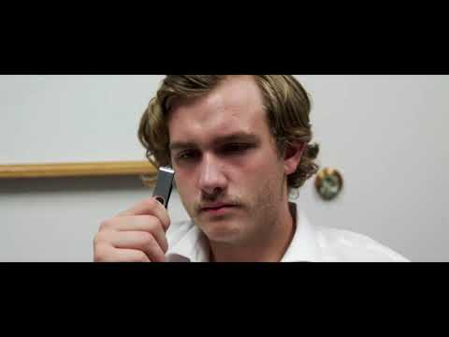
GET READY!!!
https://youtu.be/UZi18g8hH0Q
Copyright 2021 Iowa State University

Slide 4
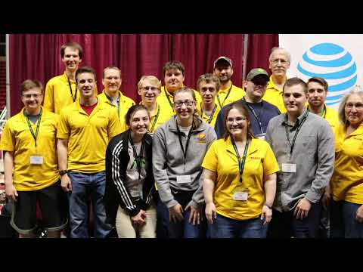
What is a Cyber Defense Competition?
https://youtu.be/W_9L5mpWlPs

Slide 5
Blue Team
https://youtu.be/-5p38gWJyGE

Slide 6
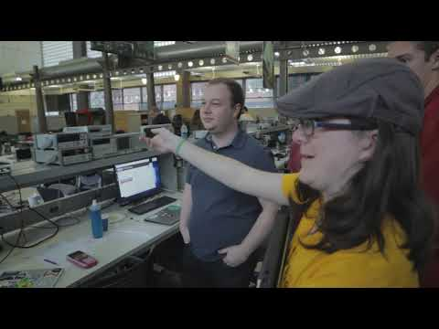
Red Team
https://youtu.be/4E1W_NzXW-k

Slide 7
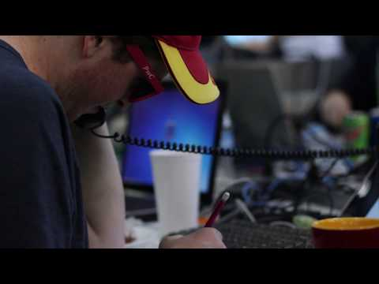
Green Team
https://youtu.be/kRVodC6VP9w

Slide 8
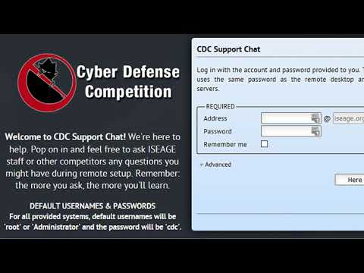
Setup Phase
https://youtu.be/0VERrjSVkq8

Slide 9
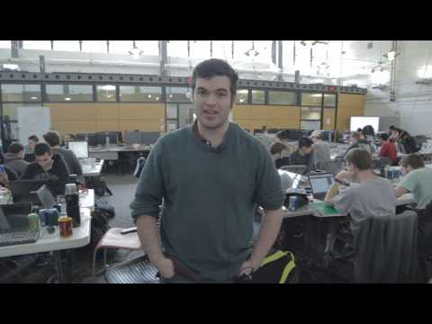
Blue Team Strategies
https://youtu.be/6O-Rda8trzU

Slide 10
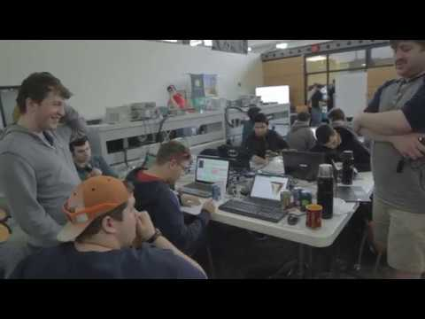
Attack Phase
https://youtu.be/uwEAe4k3TiI

Slide 11
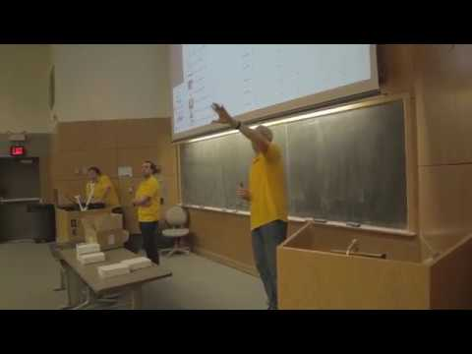
Debrief Phase
https://youtu.be/fKNYmP1-dsk

Slide 12
To Do
Review the “CDC Overview”
Read your scenario
Start planning your VM setup/fixes
Copyright 2021 Iowa State University

Slide 13
Questions?
Contact Innovate-IT support staff!
email:
innovate_it@iastate.edu

